Slide 1
Target Tap
Chris, Kevin, Ashish

Slide 2
Requirements and how it evoked
-First idea came as a target that moved around and you gain points for accuracy.
-Different settings and game modes
-Requirements:
-Fully working settings menu
- Moving target buttons with score

Slide 3
How did we divide the work?
Each person worked equally depending on the task needed.
Each person was assigned a task and once the task was completed they were assigned a new one.
Each person: coded, wrote/reviewed documents, constructed UMLs, and put in ideas.

Slide 4
Chris’s Work
- Settings Menu
- Read In Class
- Main Menu
- Mode Menu
- Connecting the menus together
- Cleaning code in game class
- Implementing high score and subtraction of points
- Run game class
- UML Diagrams

Slide 5
Kevin’s work
-Timer
-Timer loops/errors
-High score
-Game runtime/score
-UML diagrams
-Updating basic game settings

Slide 6
Ashish’s work
Button inside a button
Adding points
Action Listener for each button
Calculating points and moving the target every time the user hits the target.
UML Diagrams

Slide 7
How it works
- Main Screen
- Settings Menu
- Mode Menu
- Game
- Keep clicking
- 10 seconds to start
- each click subtracts 0.5 seconds from overall timer (if on medium), 10 *click* reset to 9.5 *click* reset to 9 until 0.5 seconds
- 3 buttons with different values
- Missing a button subtracts more than you can get
- End shows score and high score

Slide 8
Problems and Fixed Problems
- Implementing multiple buttons
- Overlapping buttons
- Implementing a timer
- Created timer that reduced time as player scores more
- Implementing a settings menu
- Created a file to write and read setting from, each with their own specific value. Read in at game play
- Implementing a high score menu
- Still unimplemented
- Implementing a score bar on screen
- Still unimplemented

Slide 9
Major Classes
Game
Settings Menu
Read In

Slide 10
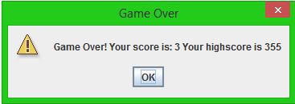
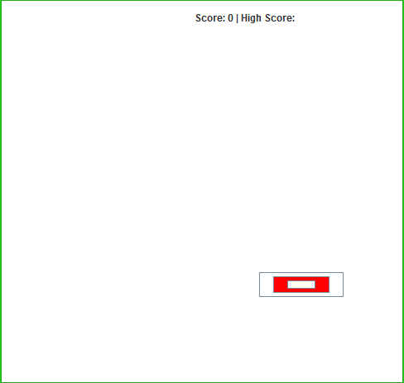
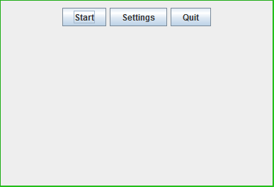
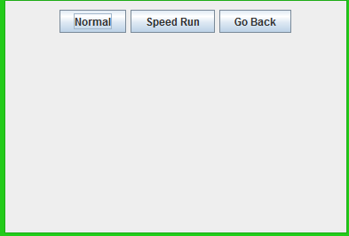
Screenshots

Slide 11
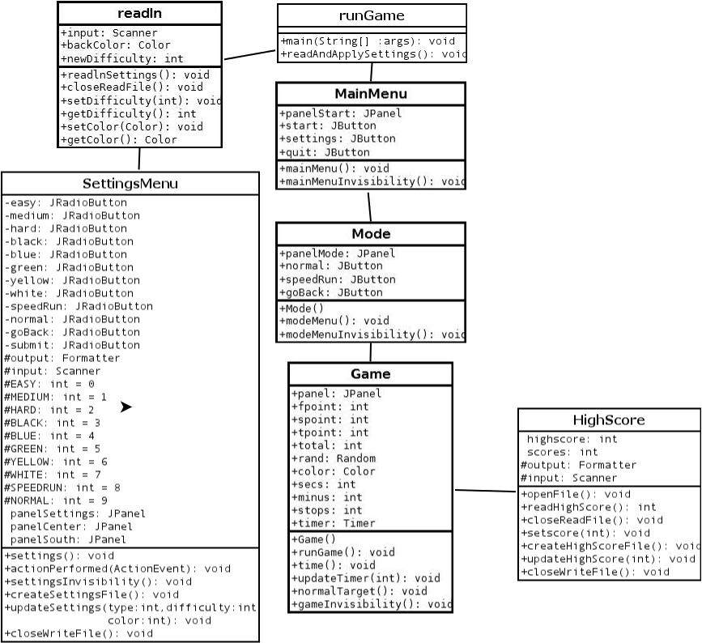
UML diagram

Slide 12
DEMO

